Slide 1


Introduction to Water Chemistry & Hardness
Course Code: ETMLCH104
Course Name: Engineering Chemistry
Program: B.Tech. (AI/ML)
Unit 2: Chemical Fuels
Dr. Mehak Ahuja
Assistant Professor, Department of Chemistry
School of Basic and Applied Sciences
K.R. Mangalam University
Sohna Road, Gurugram

Slide 2

Course Overview
UNIT WISE DETAILS ​ ​ ​
Unit Number: 1 ​ | Title: Water technology ​ | No. of hours: 6 ​
Content Summary: ​ Introduction, water analysis: Hardness-determination by EDTA method, Treatment of boiler feed water: Internal treatment (Phosphate, Colloidal and Calgon conditioning). External treatments: Ion exchange and lime-soda process, Zeolite processes. Boiler scales formation and ill effects, methods of prevention of scales. Numerical problems ​
Unit Number: 2 ​ | Title: Chemical Fuels ​ | No. of hours: 9 ​
Content Summary: ​ Fuels: Introduction, classification, calorific value (HCV & LCV), Determination of calorific value of fuel using Bomb calorimeter. ​ Solid fuel: Coal- its analysis by proximate and ultimate analysis, Numerical problems. ​ Liquid fuels: Refining of petroleum, Petroleum cracking, Knocking in IC engine, its ill effects and prevention of knocking. Anti-knocking agent: Leaded and unleaded petrol. ​ Gaseous fuels: LPG, CNG and their applications. ​
Unit Number: 3 ​ | Title: Battery Technology ​ | No. of hours: 10 ​
Content Summary: ​ Introduction - Galvanic cell, electrode potential, EMF of the cell and cell representation. Batteries and their importance, Classification of batteries- primary, secondary and reserve batteries with examples. Battery characteristics - voltage, capacity, energy density, power density, energy efficiency, cycle life and shelf life. ​ Construction, working and applications of: Ni-Cd, and Lithium-ion battery. Working principle of an electric vehicle. ​
Unit Number: 4 ​ | Title: Polymer ​ | No. of hours: 5 ​
Content Summary: ​ Basic concepts of polymer, Types of polymers, Thermoplastic & thermosetting plastics, Preparation and application of some industrially important polymers (Natural rubber, Buna S, Buna-N, Neoprene, Isoprene, Nylon-6, nylon-6,6 , Decron and Terylene). Conducting and biodegradable polymers. ​

Slide 3
COURSE OUTCOMES
CO1: Understand the methods for water hardness and the basics of boiler water treatment and analyze fuel calorific values and battery.
CO2: Explain the characteristics and working principles of different battery types and types of fuels.
CO3: Determine the differences between batteries and fuel cells and classify fuel cell types based on their components..
CO4: Identify between hard and soft water, solve the related numerical problems on water purification and emf and its significance in industry and daily life.

Slide 4
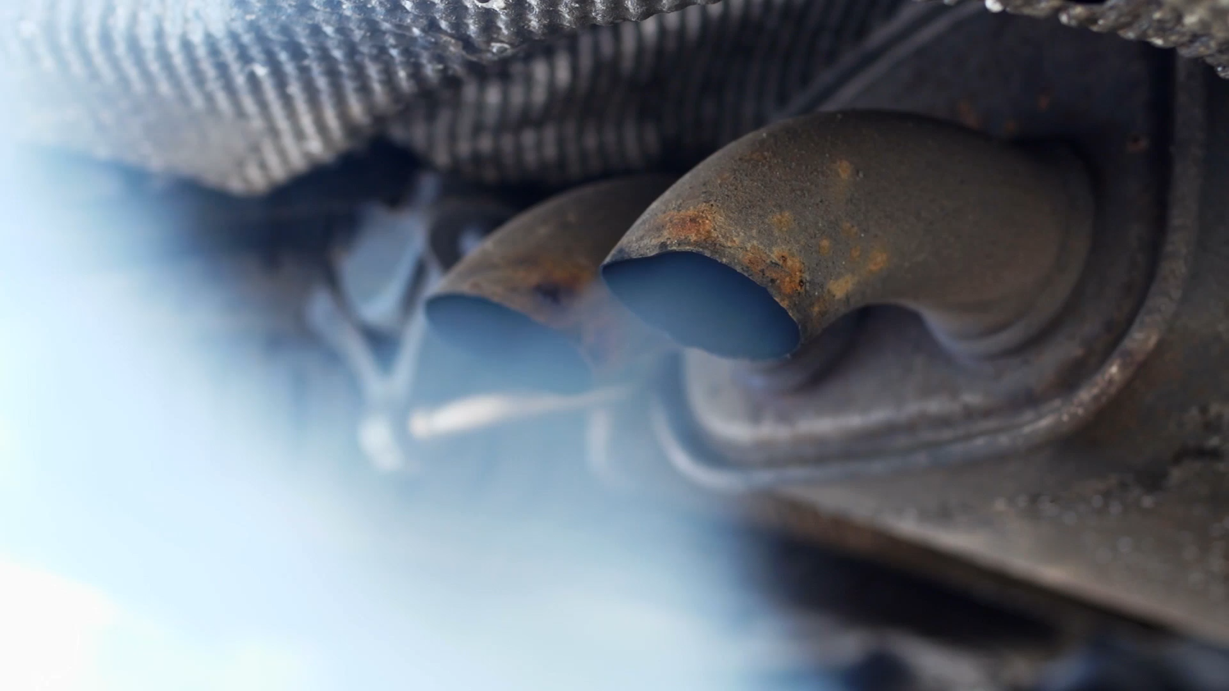
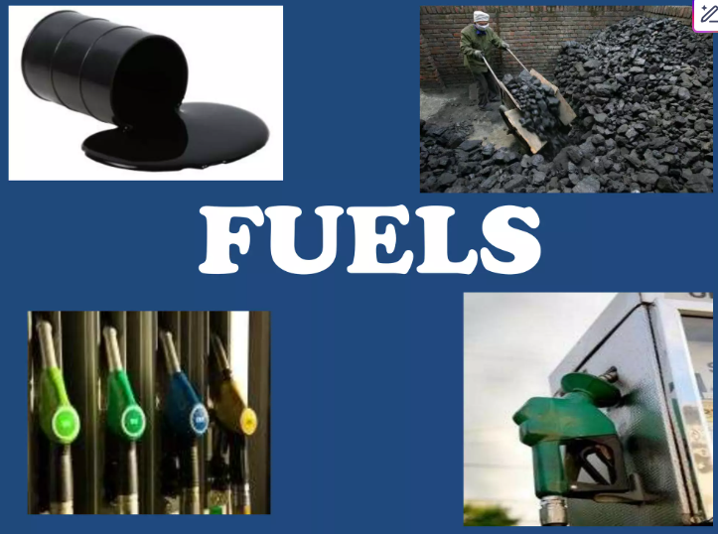
Unit 2- Fuels
Introduction
and Classification

Slide 5
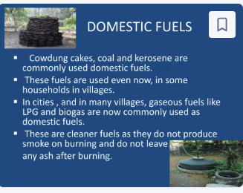
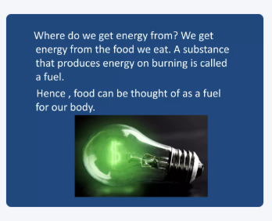
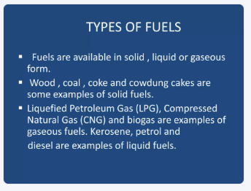
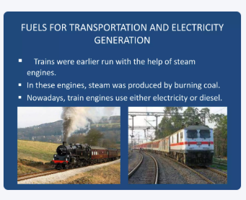
Fuels are combustible substance which on burning in the presence of oxygen or air give large amount of heat that can be used economically for domestic and industrial processes.

Slide 6
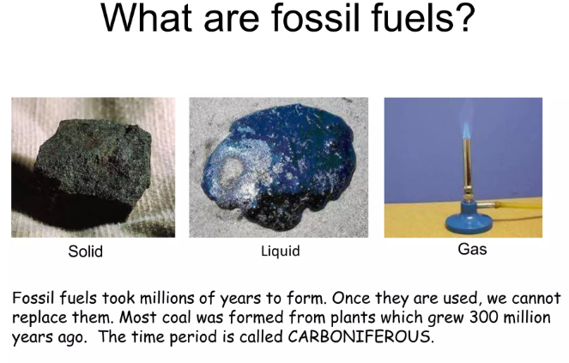


Slide 7
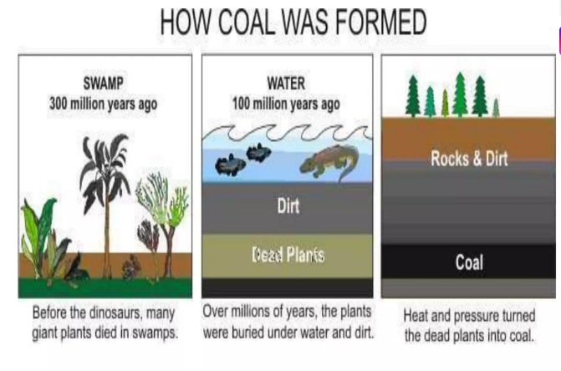

Slide 8
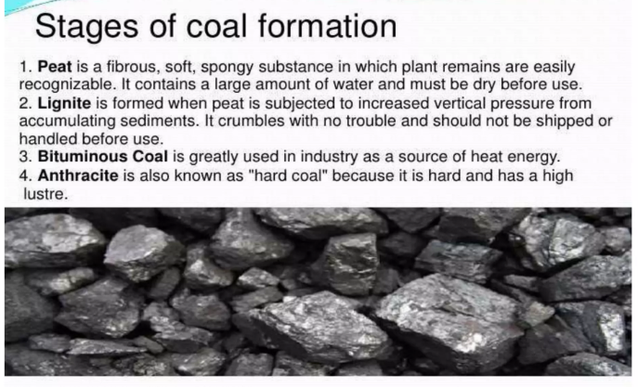

Slide 9
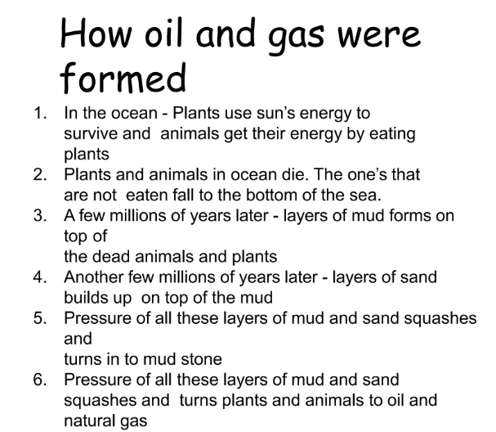

Slide 10

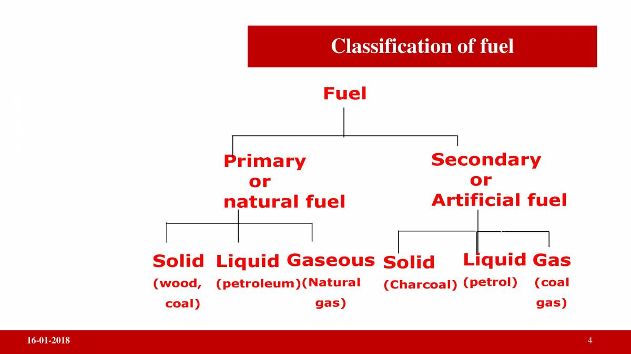
Classification of Fuel
On the Basis of there Occurrence
Fuels which are found in nature are natural fuels eg. Coal, peat, wood and Natural gas.
While the fuels prepared artificially from primary fuels are called artificial fuels.
Eg. Coke, kerosene oil
Notes:
New Courses replaced with New Programmes

Slide 11
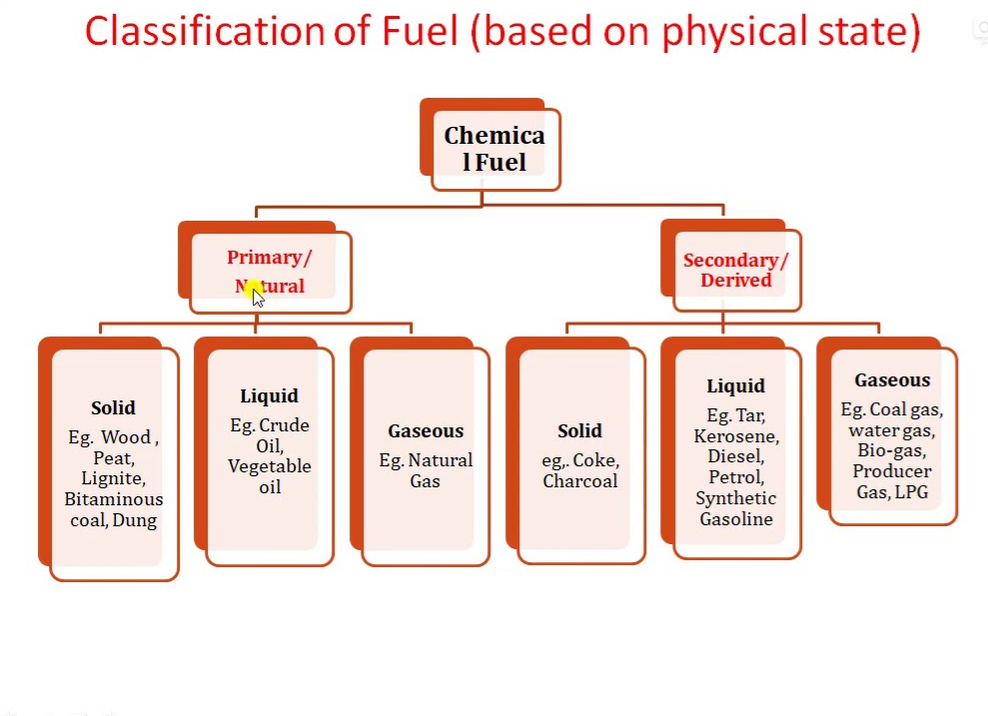

Slide 12
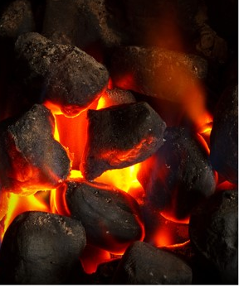
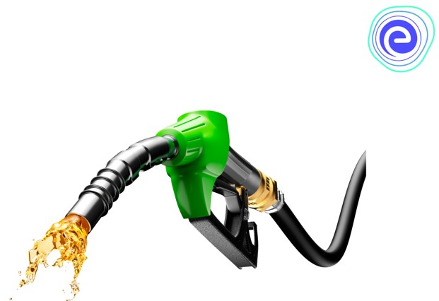
Classification of Fuel
On the Basis of there Physical state
All matter in the universe is divided into solid, liquid, and gas states.
1. Solid Fuel – All the fuels that exist in a solid-state are known as solid fuels.
Example: Coal, Bituminous, Anthracite, Peat, Wood, Coke, Charcoal, etc.
2. Liquid Fuel – All the fuels that exist in the liquid state are known as liquid fuels. Example: Diesel, Petrol, Kerosene, Crude oil.
3. Gaseous Fuel – All the fuels that exist in the gaseous state are known as gaseous fuels.
Example: Natural gas, Biogas, Water gas, etc.
Notes:
New Courses replaced with New Programmes

Slide 13
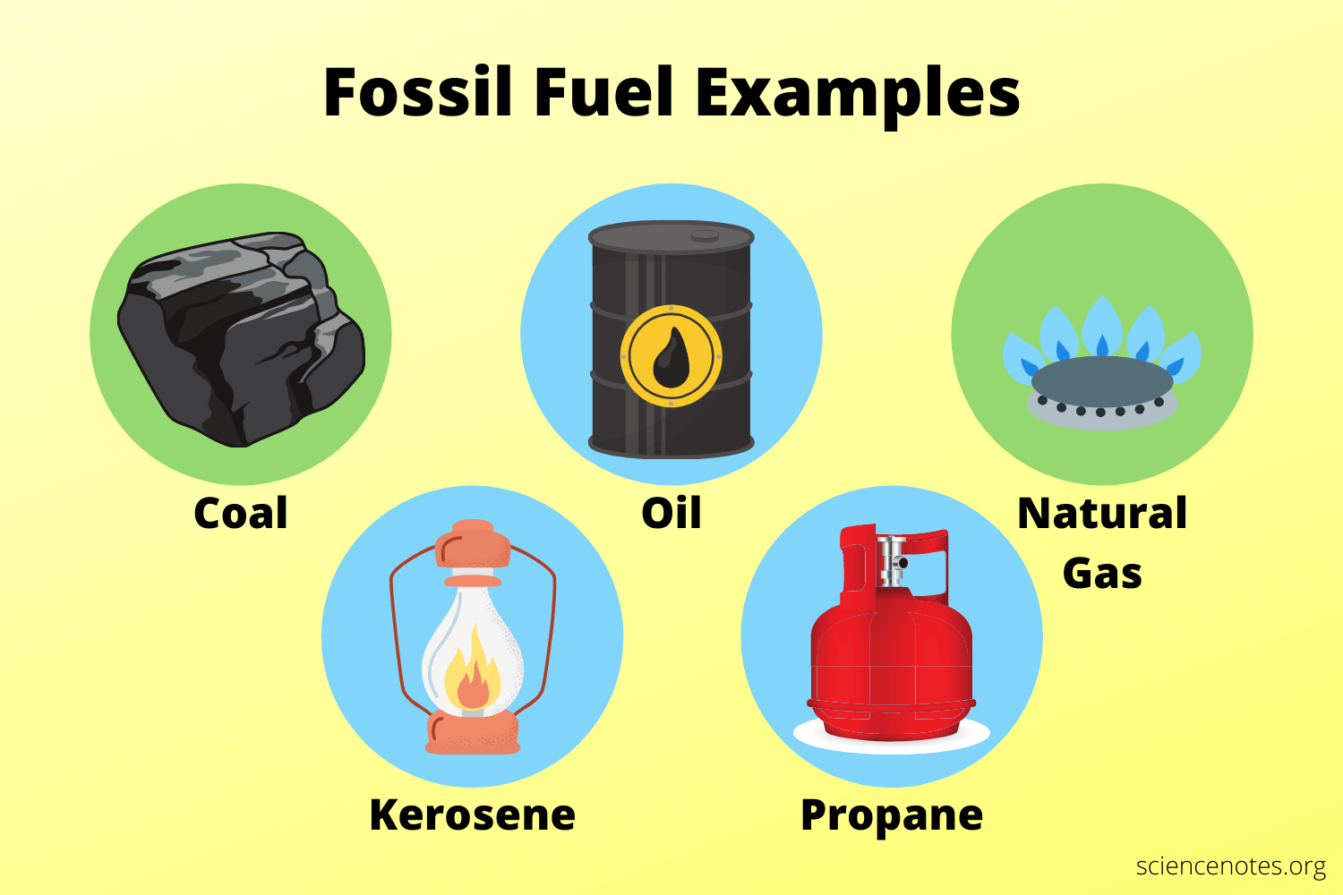

Slide 14
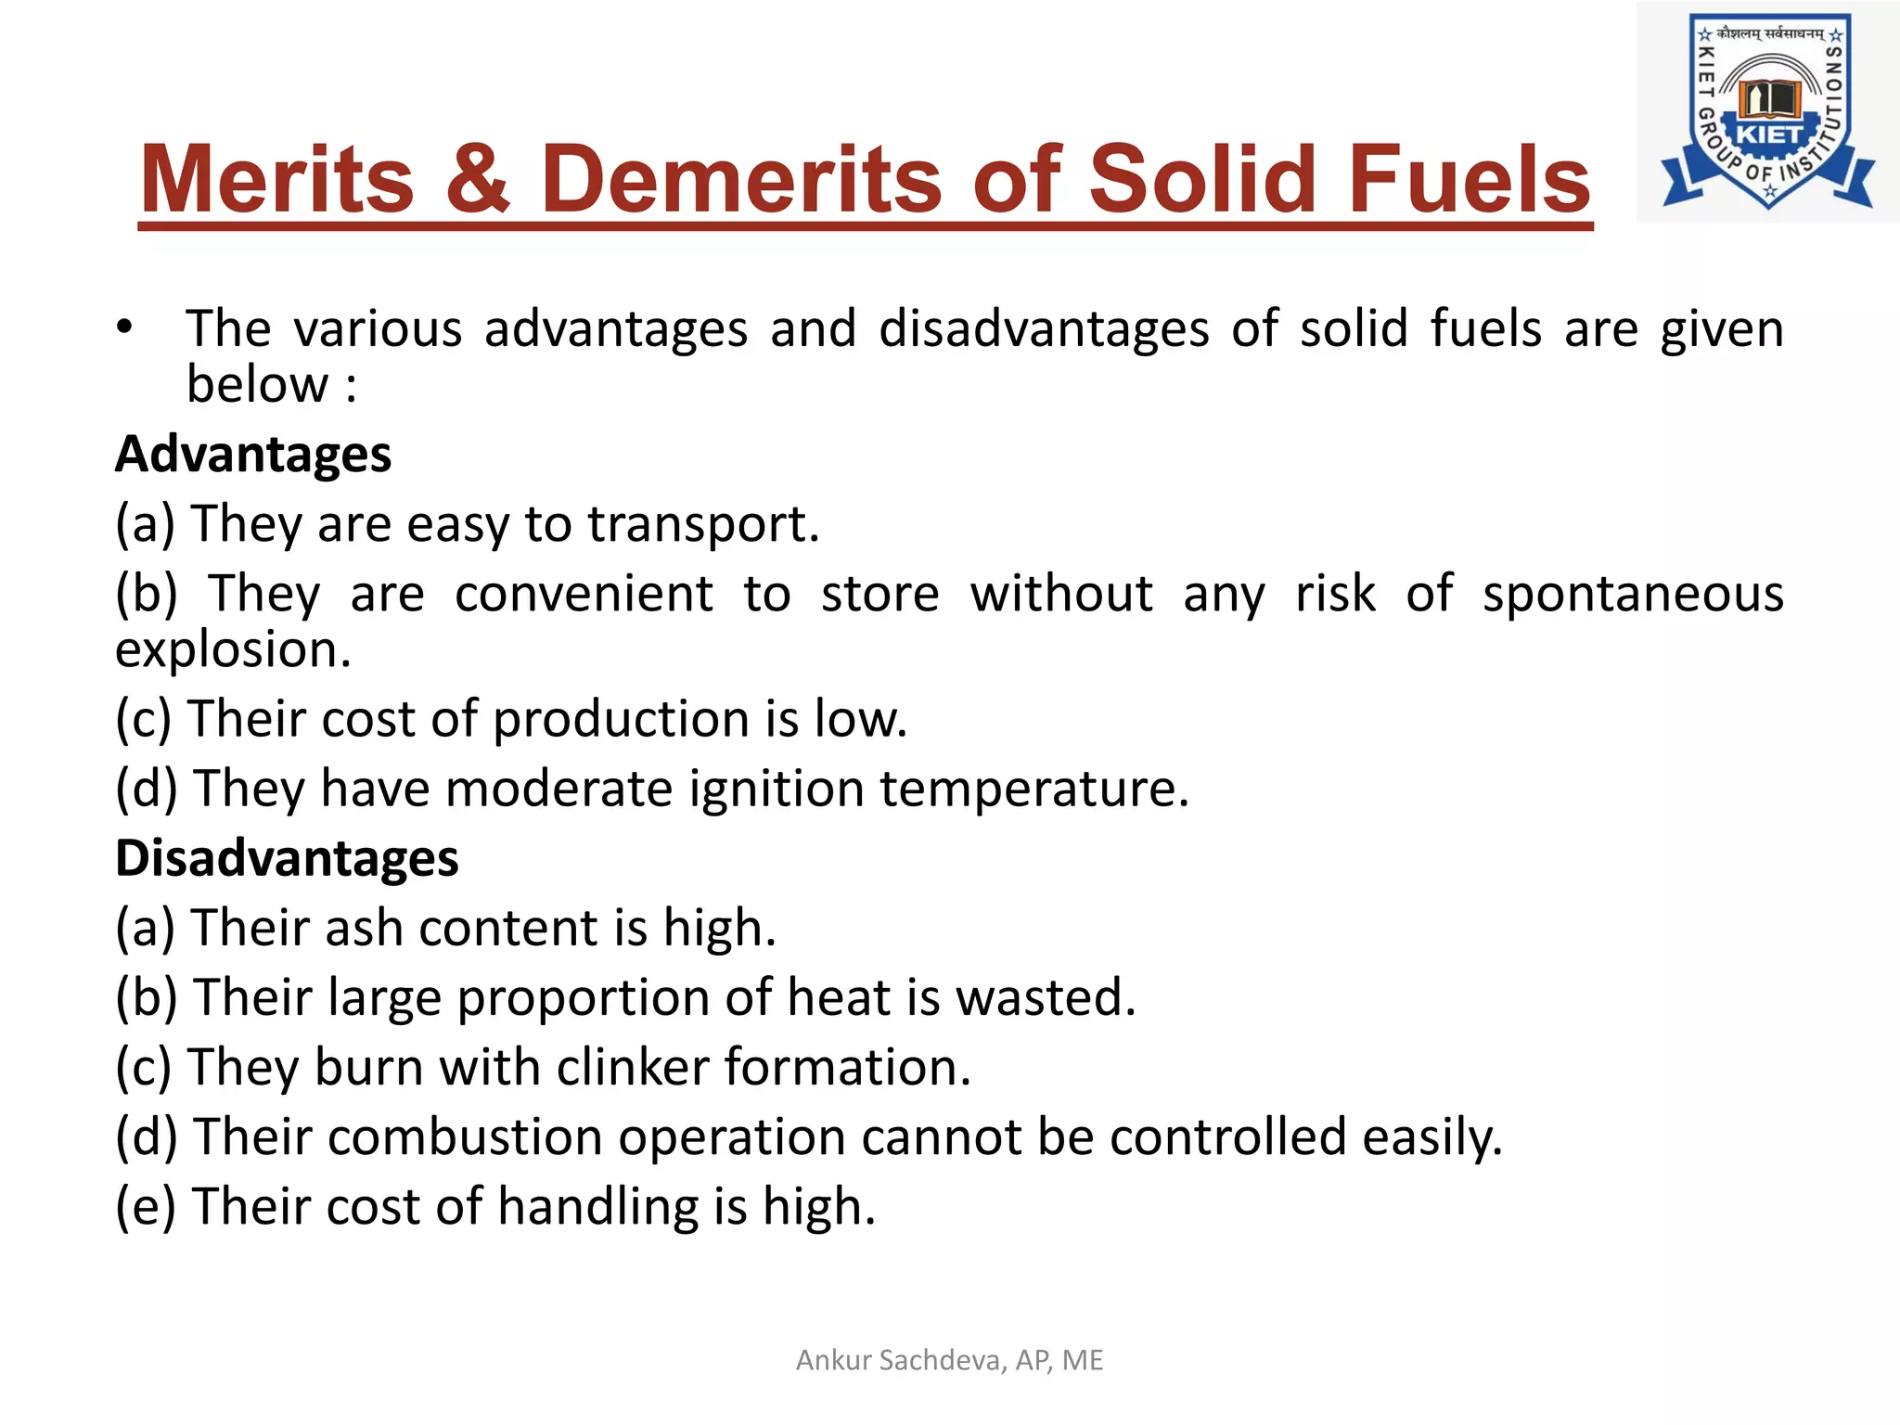

Slide 15
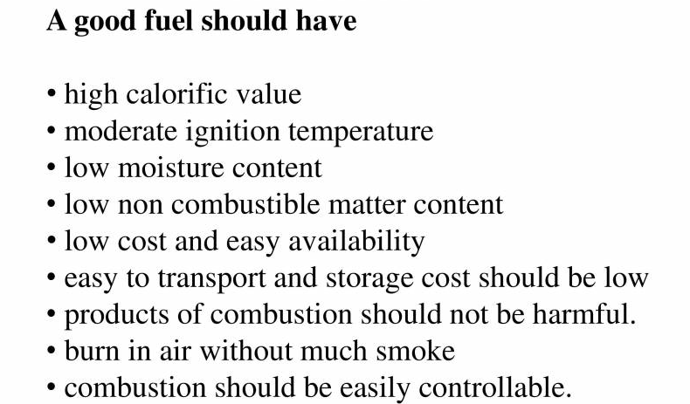
Characteristics of a Good Fuel
Notes:
New Courses replaced with New Programmes

Slide 16
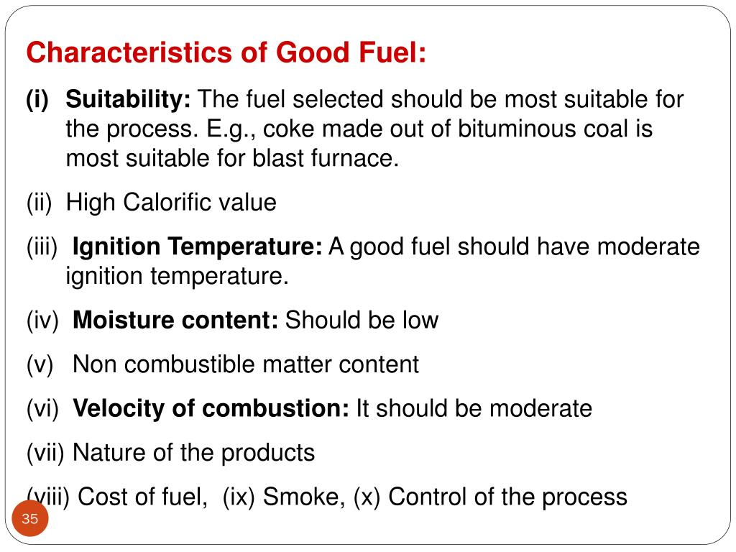

Slide 17
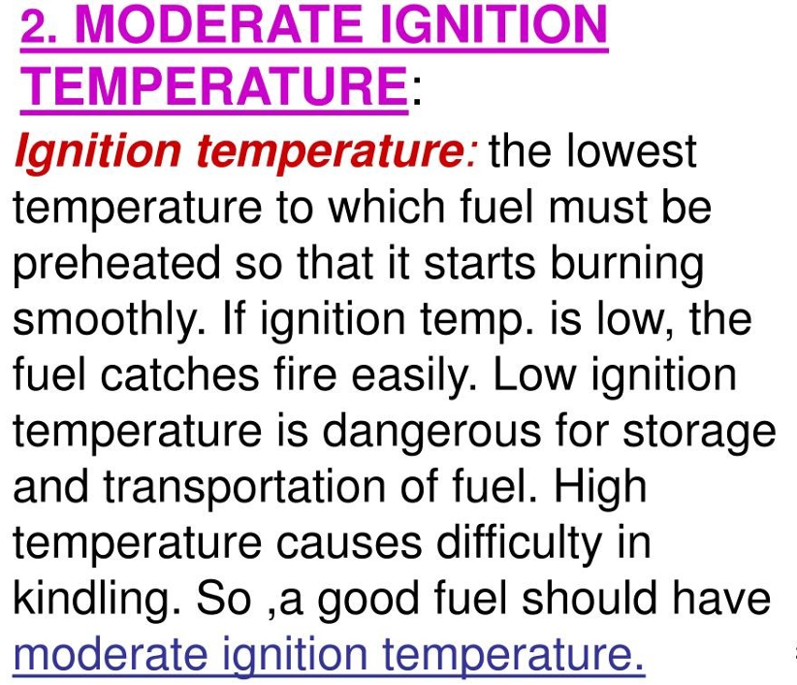

Slide 18
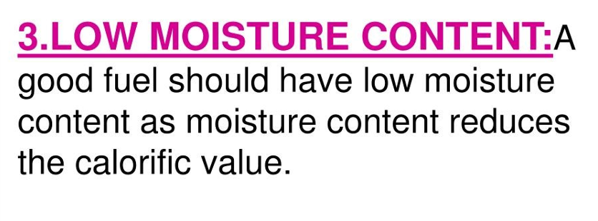

Slide 19
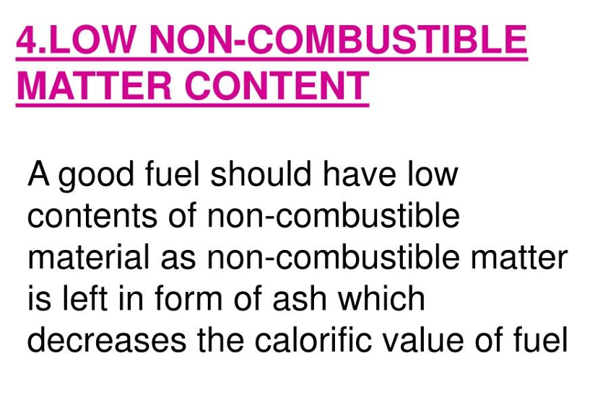

Slide 20
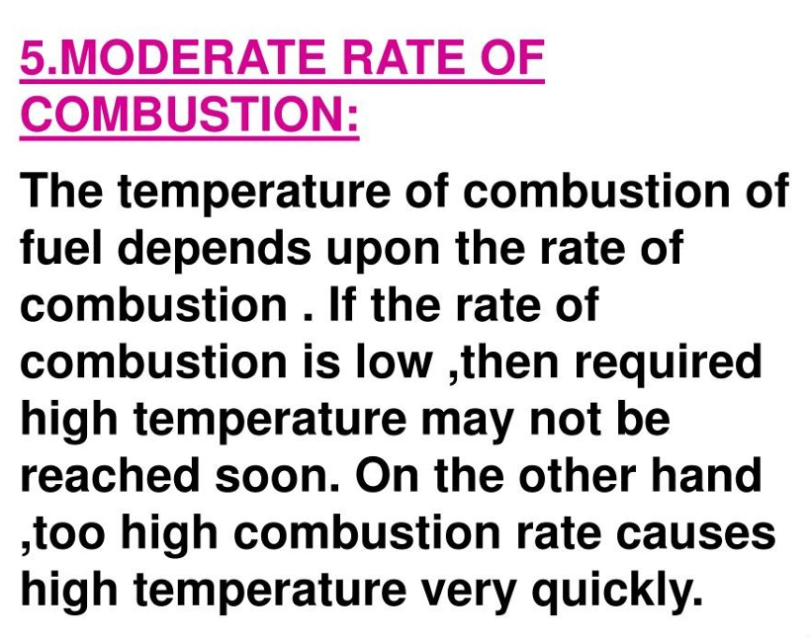

Slide 21
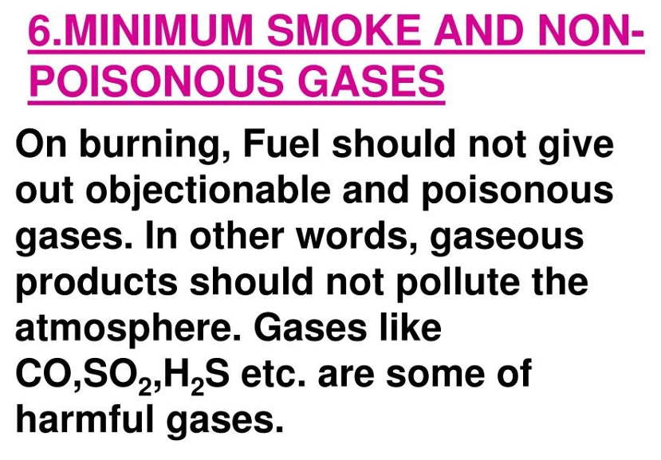

Slide 22
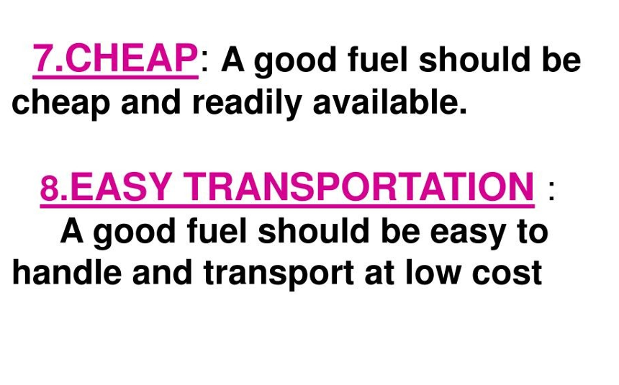

Slide 23
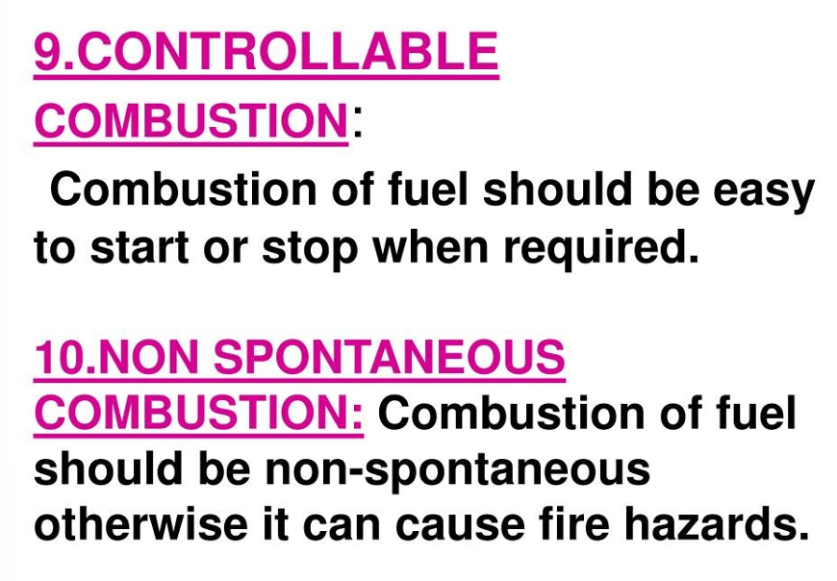

Slide 24
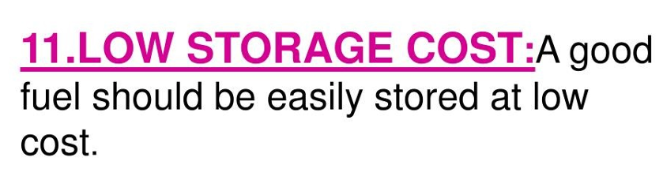

Slide 25
Take away of the session
Definition: Fuels are substances that produce heat and energy on combustion.
Types of Fuels:
Solid fuels: Coal, wood, coke
Liquid fuels: Petrol, diesel, kerosene
Gaseous fuels: Natural gas, LPG, biogas
Ideal Fuel Characteristics: High calorific value, easy ignition, low residue, safe to transport/store, low cost.
Uses: Fuels are used for domestic, industrial, transportation, and power generation purposes.
Calorific Value: The amount of heat produced by the complete combustion of 1 gram or 1 kg of fuel, measured in kJ/kg or kcal/kg.

Slide 26
1. What is a fuel? A. Substance used for cleaning B. Substance that absorbs heat C. Substance that produces heat on combustion D. Substance that conducts electricity ✅ Answer: C
2. Which of the following is a gaseous fuel? A. Wood B. Diesel C. LPG D. Kerosene ✅ Answer: C
3. The calorific value of a fuel is: A. Amount of fuel needed to produce 1°C rise B. Amount of heat produced by burning 1 unit mass of fuel C. Cost of fuel per unit D. Density of fuel ✅ Answer: B
4. Which of these is not a characteristic of an ideal fuel? A. High calorific value B. Produces toxic gases C. Easy to store and transport D. Leaves little or no residue ✅ Answer: B
5. Which of the following is a solid fuel? A. Petrol B. Biogas C. Coal D. Natural gas ✅ Answer: C
Questions

Slide 27
Learning Outcomes
BTL-1: Recall definitions and types of fuels (CO2)
BTL-2: Explain characteristics of solid, liquid, and gaseous fuels;
define calorific value (CO1, CO2)
BTL-3: Apply knowledge to identify ideal fuels and solve questions
related to fuel properties (CO1, CO2)
CO1: Understand the methods for water hardness and the basics of boiler water treatment and analyze fuel calorific values and battery.
CO2: Explain the characteristics and working principles of different battery types and types of fuels.
Mapped Course Outcomes

Slide 28
References
Engineering Chemistry by Jain and Jain.

